Slide 1
Realize. A better world through research
November 10, 2015
Flash of Genius
The First steps after an Invention
Divyesh Patel

Slide 2
Agenda
Patents
U of R IP Policy and Funder IP Policy
Disclosure Form
IP Evaluation Criteria
Proposed Support Services

Slide 3
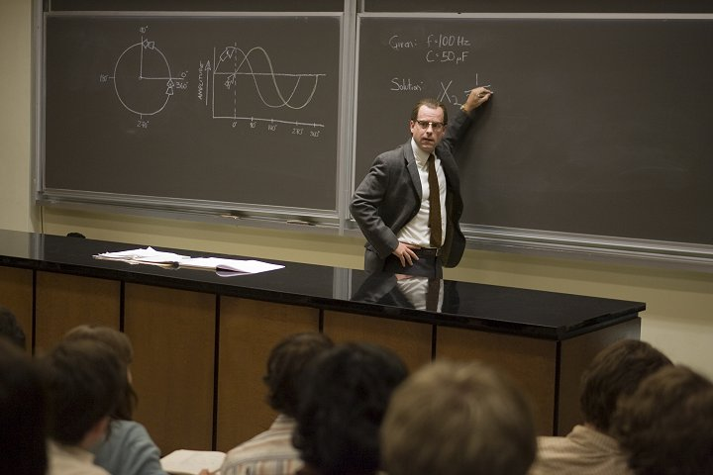
Flash of Genius
Dr. Bob Kearns and the intermittent wiper
Concept defining invention
Replaced by doctrine of nonobviousness
What is nonobvious in your discipline?
Notes:
Stars Greg Kinnear, article in the New Yorker
Flash of genius failed because it didn’t recognize ideas that weren’t immediately recognizable as innovative (ie: and electric lighter) but required significant effort to develop
Non obvious changes depending on the discipline and is still not well known

Slide 4
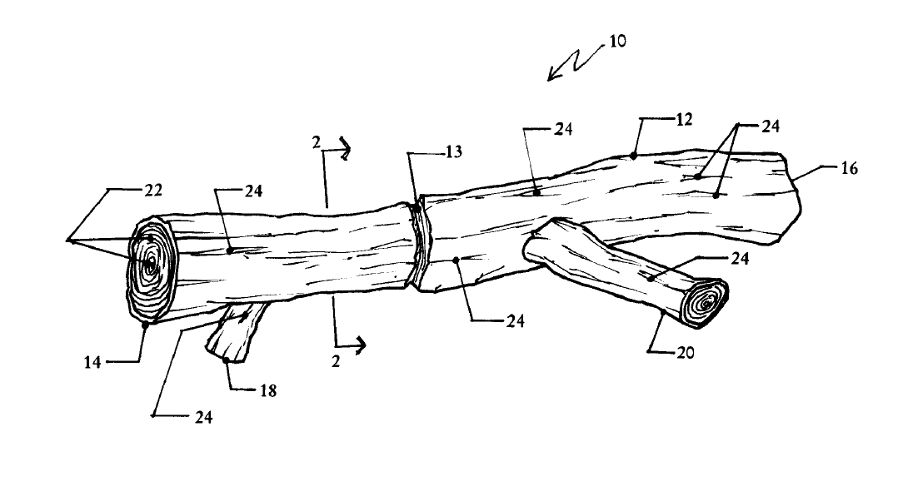
Patentability
Patentable subject matter
Canada: Physical embodiments of an idea
US: Process, machine, manufacture, or composition of matter
EU: Provides guidance on what ISN’T patentable
Novel
Non-obvious
Reduction to practice
Useful
Notes:
An apparatus to be used as a toy by an animal

Slide 5
IP Policy
You own your IP and only you can decide to pursue commercialization
The University has a right to co-commercialize if specialized resources were used in the development
Encouraged to disclose to discuss how to protect interests of all parties
This can be modified in contractual arrangements

Slide 6
Funder Requirements
NSERC: “As a condition of accepting an award, grantees agree to disclose to their institutions any IP with commercial potential arising from the award, should they decide to commercialize.”
NSERC wants IP managed for the “benefit of Canada”
Sponsors: “The University will notify the Sponsor promptly after identifying any Result that the University believes is patentable, and will supply the Sponsor with copies of that Result.”
Depends on negotiated agreement
Evaluate on a case-by-case basis
Notes:
Depends on the Sponsor and funding arrangements, it may simply be a notification or we may need to give up IP

Slide 7
Disclosure Form

Slide 8
Disclosure Form
Sources of Funding Used for Research
Use of Specialized Resources
Publications or Presentations
People and Partners involved in Research
Due Diligence
Notes:
Sources of funding – grants and research contracts - helps us determine any obligations to funders
Specialized resources – Compliance with U of R policy
Publications – Novelty – once it’s disclosed, it is no longer novel – encourage to discuss with us prior to publication
People, partners, etc. Unlike publications, patents must identify all parties involved an only those involved or it is grounds for invalidation of patent

Slide 9
Technology Evaluation
Technology Commercialization Objectives are varied
Licensing revenue
Sponsored research
University – Industry Partnership development
Start-ups
Economic Development

Slide 10
Technology Evaluation
4 Criteria for investment in patents
Patentability
Obviousness
Public Disclosures
Scope of claims (broadness of patent protection)
Commercial Value
Nature of Technology – breakthrough or incremental advancement
Competitors
Market Asssesment
Value proposition for Technology

Slide 11
Technology Evaluation
Maturity of Technology
Inventor Participation

Slide 12
Investment Decision Matrix
Category | Patentability | Marketability | Maturity Stage | Go/No-go | Activity
1 | Narrow | Low | Early or Late | No-go | Abandon or assign rights back to inventors
2 | Broad | Low | Early or Late | No-go | Abandon or assign rights back to inventors
3 | Narrow | High | Early | Further diligence required | Seek collaborators for sponsored research
4 | Narrow | High | Late | Go | Seek licensee with non-exclusive terms
5 | Broad | High | Early | Go | Actively seek licensee with option terms
6 | Broad | High | Late | Go | Actively seek licensee for exclusivity

Slide 13
Support for Faculty
Currently
Future
Limited support for new IP development
Review IP disclosures for encumberances
Provide high level advice on commercialization options
Developed an IP commercialization model
Staged process that starts with Technology Evaluation Framework
Uses Commercialization Advisory Group to provide guidance
Looking for Pilot Project

Slide 14
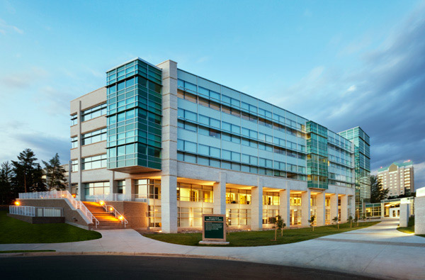
Questions?
Divyesh Patel
Manager, Research Partnerships
Research Office
(306) 337-3293
divyesh.patel@uregina.ca

